Slide 1
Work flow

Slide 2
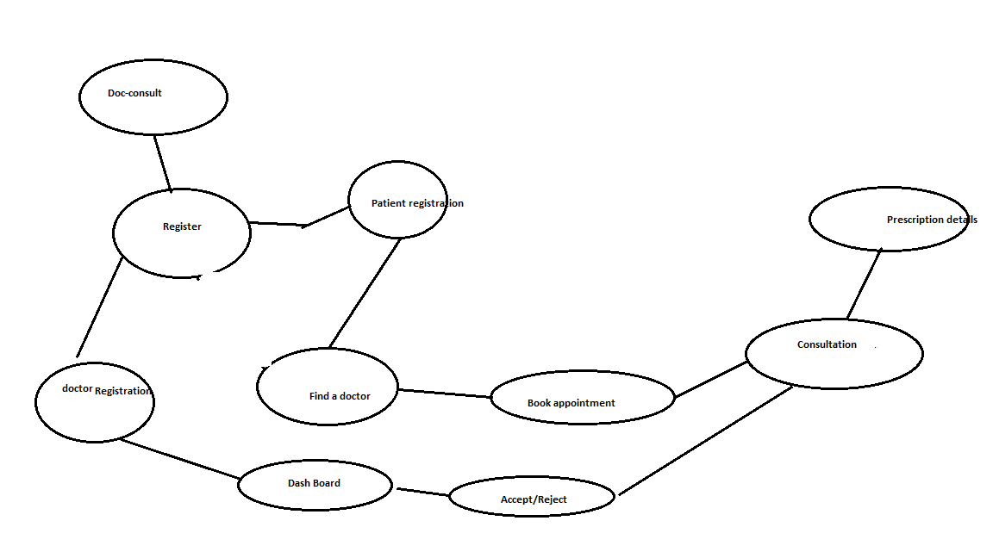

Slide 3
User/patient should be able to register in the app
User/patient should be able to enter his basic details in the app to register
User/patient after register, should be able to selects a general physician doctor available on the app.
Successfully registered and waiting for the doctor confirmation message should be displayed.
Doctor should be able to receive an notification of patient request
Doctor should be able to accept the request and appointment need to be sent to the patient
Patient should be able to receive an notification of appointment date and time
Once patient is consulted by the doctor , patient should be able to see his prescription details on the app

Slide 4
UI MOCKUP

Slide 5
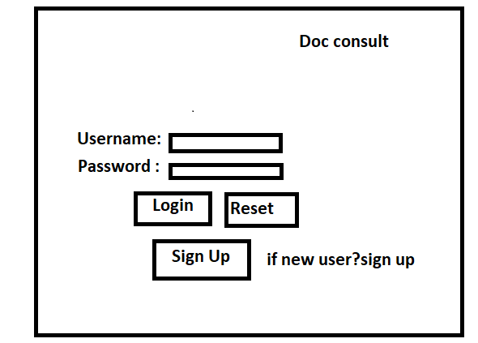

Slide 6
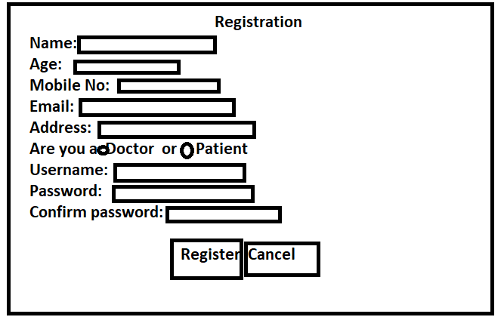

Slide 7
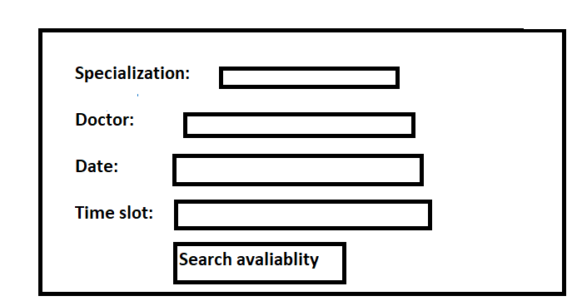

Slide 8
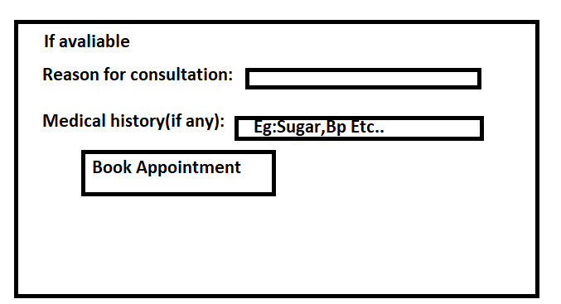

Slide 9
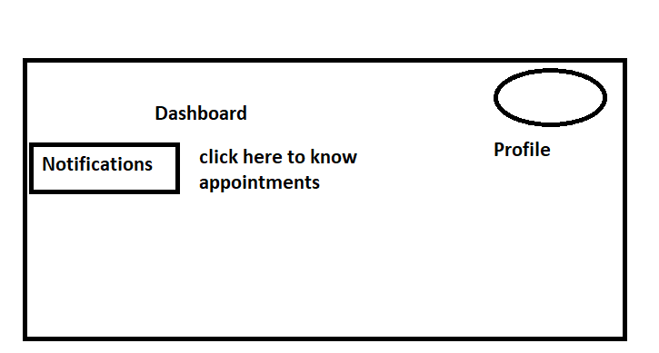

Slide 10
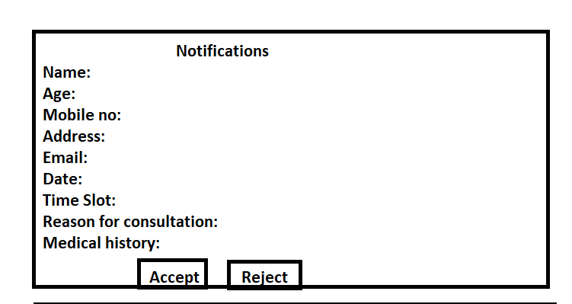

Slide 11
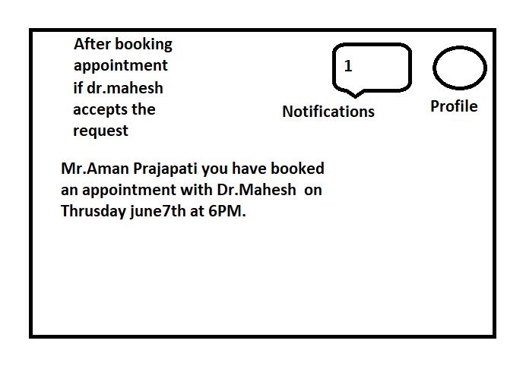

Slide 12
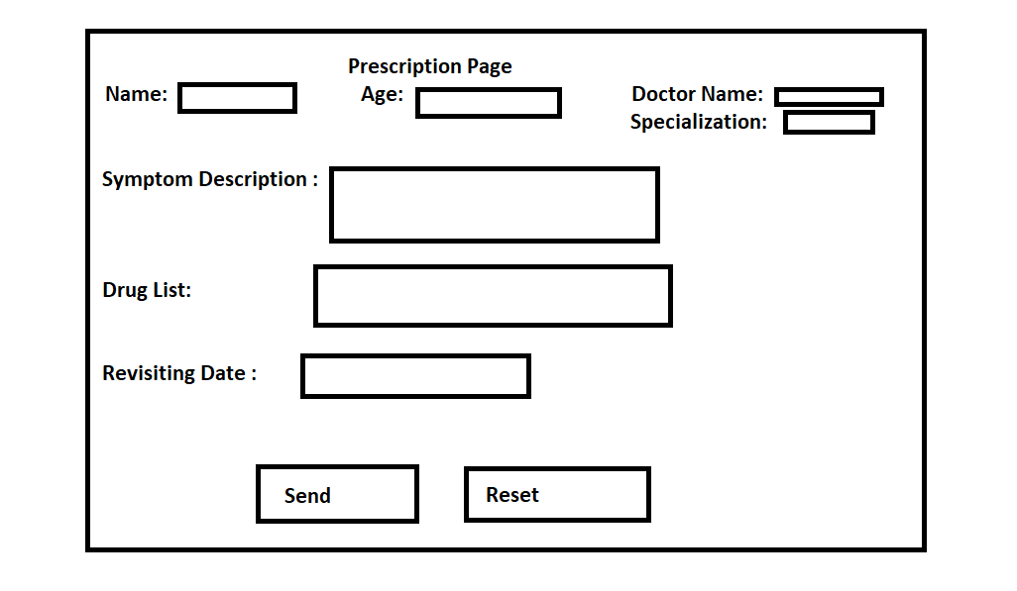

Slide 13
